Slide 1


Front-of-Pack Nutritional Labelling: The consumer perspective
Emma Calvert, BEUC
29th November 2022
‘Ask the Expert’ Session for MEPs: Nutri-Score Explained

Slide 2





















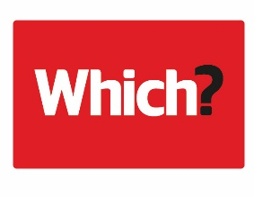

























BEUC is proud of its members
Notes:
Established in 1962
46 countries in 32 European countries
Mission = To represent consumers at the EU(ropean) level and defend their interests
Food Team: a major part of work on nutrition is to make the healthier choice the easier choice

Slide 3
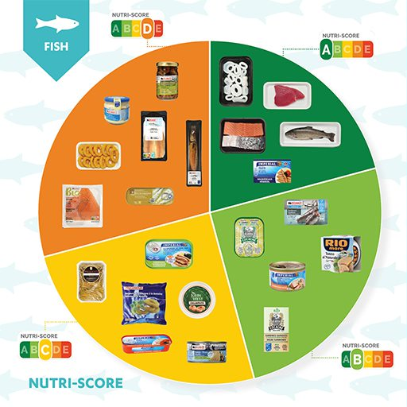
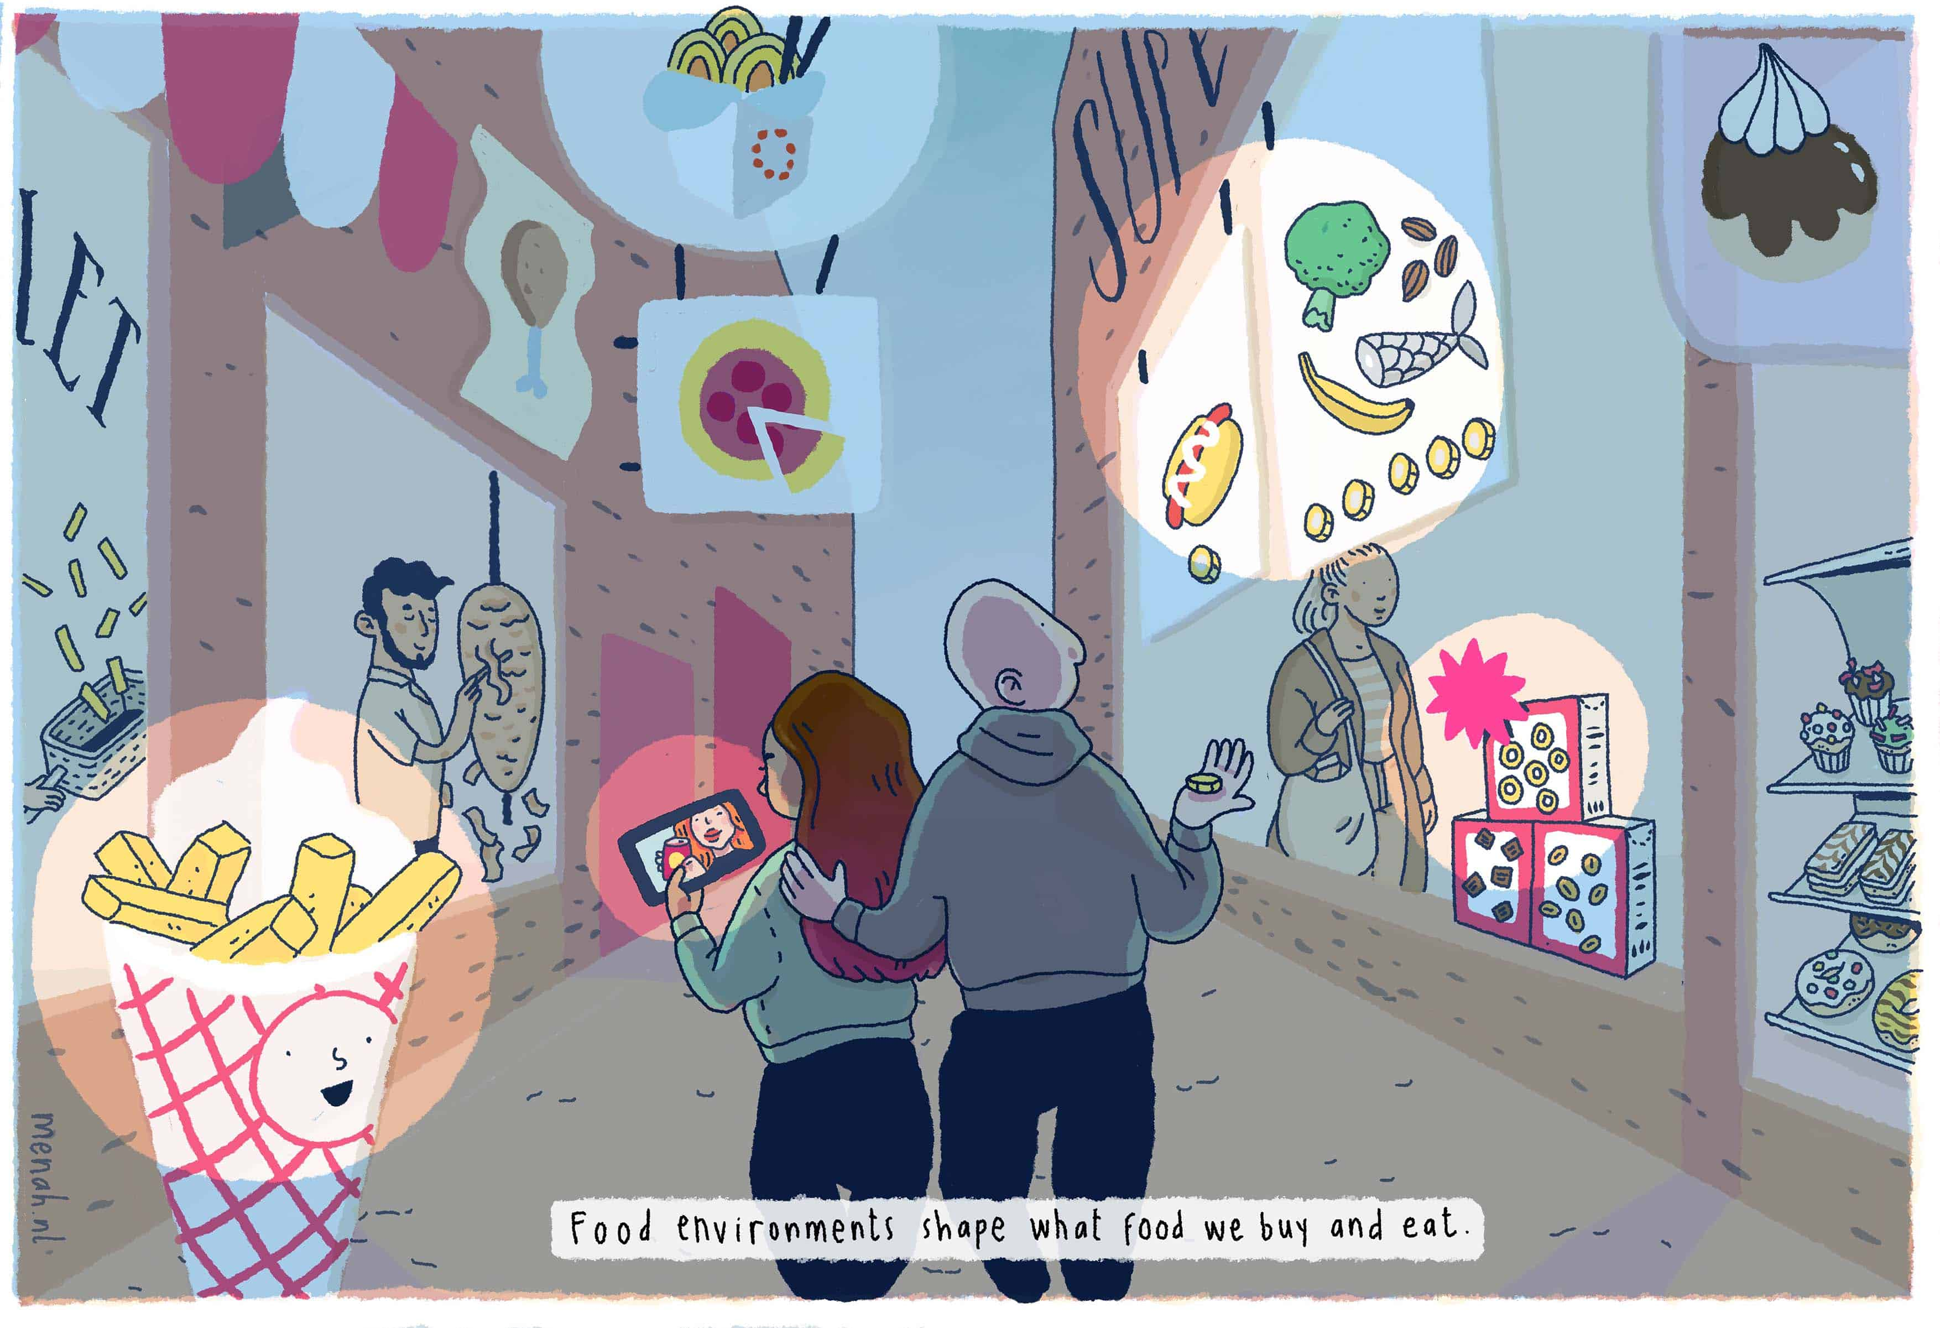
FOP LABELS are only one part of the solution
There is no ‘silver bullet’ to solve all the problems of the food system
‘Food environments’ need to enable healthier choices
FOPNLS can complement dietary guidelines

Slide 4
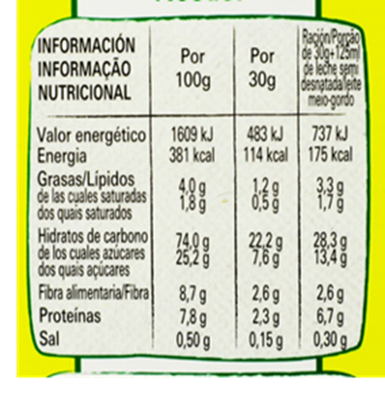
Front-of-pack Nutritional Labelling in the EU today
Food Information to Consumers Regulation (1169/2011) led to nutritional declaration but…​
  Back of pack
  Tiny Font
  Lacks an interpretive element
Missed opportunity to introduce front-of-pack colour-coded nutritional labelling to help consumers in their choices​
Notes:
It did include the flexibility to allow ms to introduce their own fopnls

Slide 5
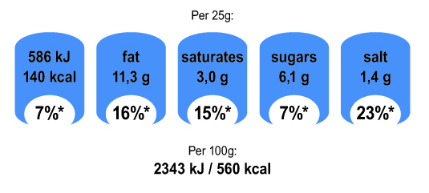
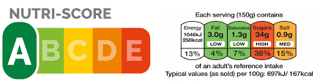
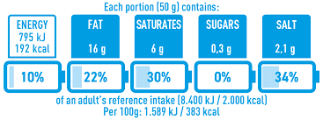


Background on FOPNL in the EU cont’d
Colour-coded interpretive labels
Monochrome portion–based FOPNL
Positive logos

Slide 6
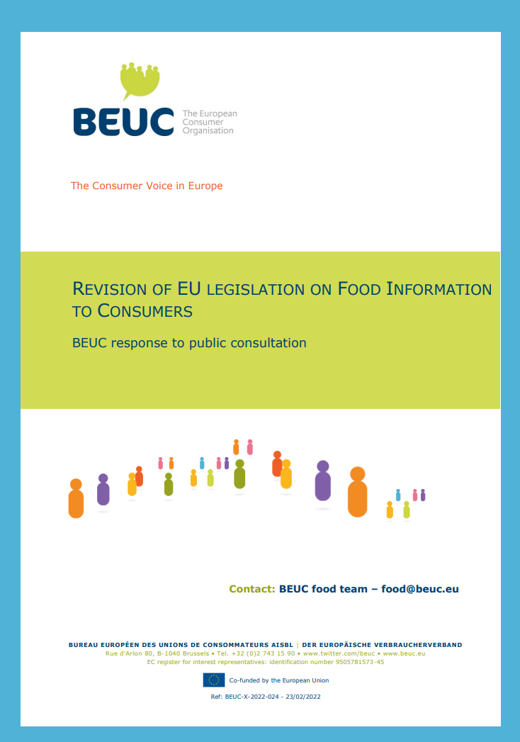
What should a FOPNL look like for consumers?
Government-led development
Across-the-board
Easily understood at-a-glance
  Interpretive
  Meaningful colour codes
  Uniform Reference Amount per 100g
Based on solid independent scientific evidence
  Objective understanding
  Purchasing intention
Mandatory
Notes:
Consumer trust
Jrc: less mental maths is beneficial and consumers tend to understand evaluative colour-coded labels more easily than reductive moncochrome ones
UFC: Aaffice ton nutriscore40% (some food brands will never show their colours voluntarily)

Slide 7
NUTRI-SCORE TICKS ALL THE BOXES
It is the easiest label to understand
It guides consumers towards healthier choices
  it makes consumers’ shopping baskets healthier
  It helps consumers eat smaller portions
It incentivizes food reformulation where feasible
Government-led initiative based on solid independent scientific evidence
BEUC Nutri-Score FAQ
Notes:
Really important in time-pressured environments. No-label comparison ++
Especially for lower socio-economic backgrounds
Study of 25000 participants showed that the NS was the best at helping consumers to select smaller portion sizes of less healthy food. But that portion-sized FOPNL did the opposite
BE: breakfast cereals : reduction of sodium and sugar

Slide 8
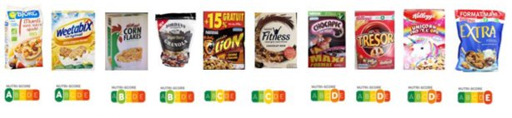
FOPNL and dietary Recommendations
Different but complementary tools →
  FBDG: Provides consumers with information on what a healthy diet is
  FOPNL: Provide consumers with information on the product level
Recommended foods in FBDG can have a wide variability of composition → FOPNL can assist consumers in real-life supermarket situations
Notes:
FBDG important backbone to national nutrition policies
BUT consumer obviously do not have a copy of these guidelines with them when they are in the supermarket
Even when consumers are aware of the dietary guidelines, the messages can be quite vague e.g. eat oily fish twice a week or limit hfsss foods

Slide 9
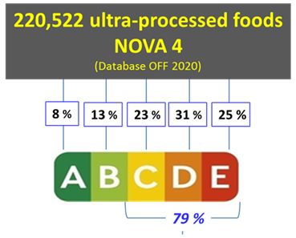
FOPNL and dietary Recommendations:
Ultra-Processed Foods
Processing and nutritional composition are different dimensions
Nutri-Score is consistent with dietary guidelines
Notes:
Upfs
Simply a translation of what is on the back of the back
Ou remembers always recommend to privilege fresh produce and home cooking. But we are aware that for multiple reasons some consuemrs will still opt for upfs – ns can help them choose a slightly healthier option in this category

Slide 10
CONCLUDING REMARKS
Let’s focus on what is best for the consumer.
A successful FOP nutritional label for the EU must be:
  Based on independent science
  Simple, interpretive and colour-coded
  Calculated per 100g/ml to allow comparing products easily
  Mandatory
Nutri-Score meets all these criteria and is currently the best-performing FOP label.
Let’s be clear on what a FOP label can/cannot do.
No system is perfect: regular systematic reviews will be needed to allow for the continuous improvement of the future EU FOP nutritional label.

Slide 11


Thank you for your attention
www.beuc.eu
@beuc
This presentation is part of an activity which has received funding under an operating grant from the European Union’s Consumer Programme (2014-2020).

